Slide 1
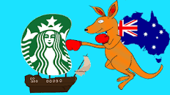

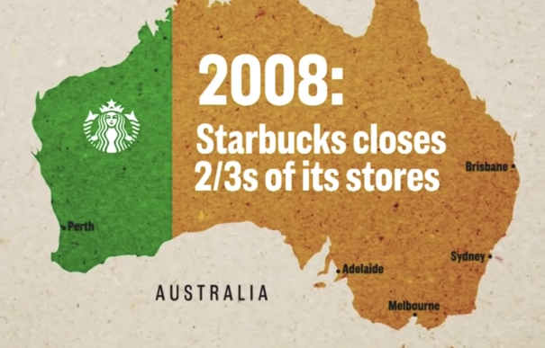

Starbucks Failed
in Australia : Detailed Analysis
Prepared By Sharad, Sumit, Bishnubrata & Saloni

Slide 2
Agenda
3 | Introduction
5 | Objectives
6 | Company Size
7 | Market Stakeholders
8 | Revenue Model
9 | Customer Analysis
10 | SWOT
11 | Competition & Market Size
12 | PESTEL Analysis
13 | Marketing Strategy
14 | What Went Wrong
15 | Conclusion & Recommendations
16 | Learnings & challenges

Slide 3

What is Starbucks?
Largest Coffehouse chain in the world
Starbucks, American company that is the largest coffeehouse chain in the world. Its headquarters are in Seattle, Washington.
Starbucks was founded by Jerry Baldwin, Gordon Bowker, and Zev Siegl, opening its first store in 1971 near the historic Pike Place Market in Seattle.

Slide 4

Australia looked like a golden opportunity for Starbucks. The country’s GDP is 1.3 trillion, making Australia the 13th largest economy in the world. The country has a thriving coffee culture. In fact, the Australian coffee industry was worth $5.8 billion USD in 2021. The first Starbucks opened in Australia in 2000.
Starbucks has coffeeshops all over the world, but what went wrong in Australia Due to which Starbucks Accumalted $105 million loss in 7 years, and closed more than two third of its stores in the continent.

Slide 5
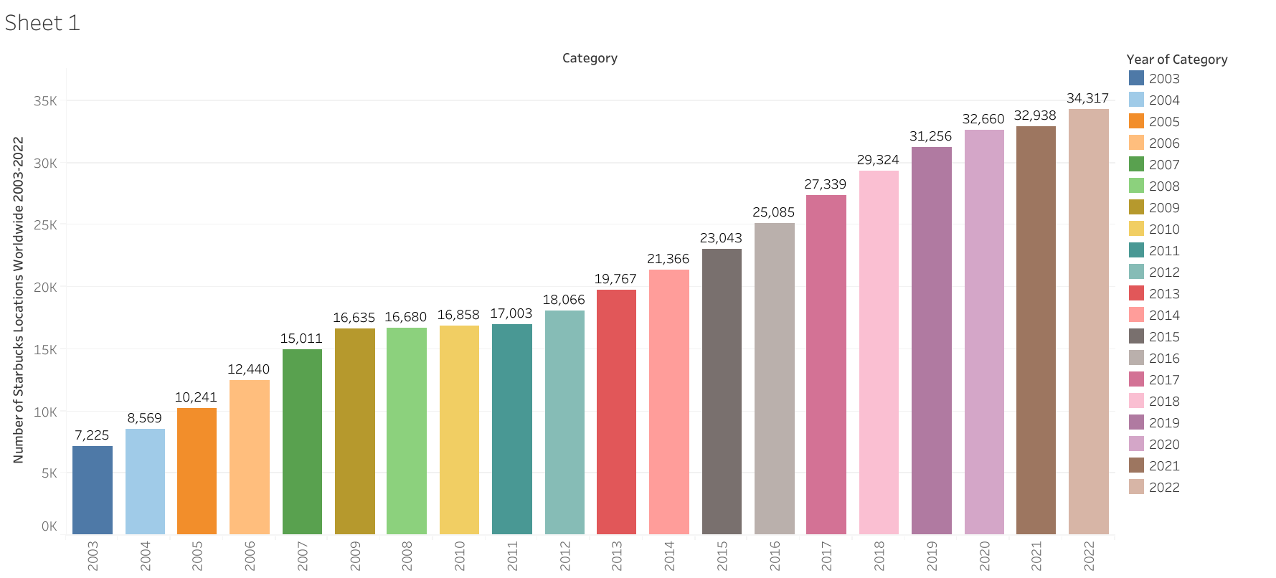
Number of starbucks locations Worldwide 2003-2022
As of today, Starbucks is the largest coffeehouse company in the world with 34,317 stores across the globe in 2022. In 2021, it recorded 32,938 stores worldwide. Starbucks year-over-year growth almost doubled in the last decade.

Slide 6
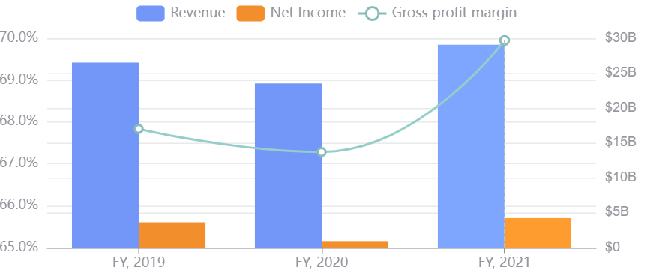
Starbucks Financials
Revenue (Q3, 2022) - $8.2B , Gross profit (Q3, 2022) - $5.5B, Net income (Q3, 2022)- $912.9M, Cash (Q3, 2022)- $3.2B, EBIT (Q3, 2022) - $1.3B, Enterprise value - $126.2B

Slide 7
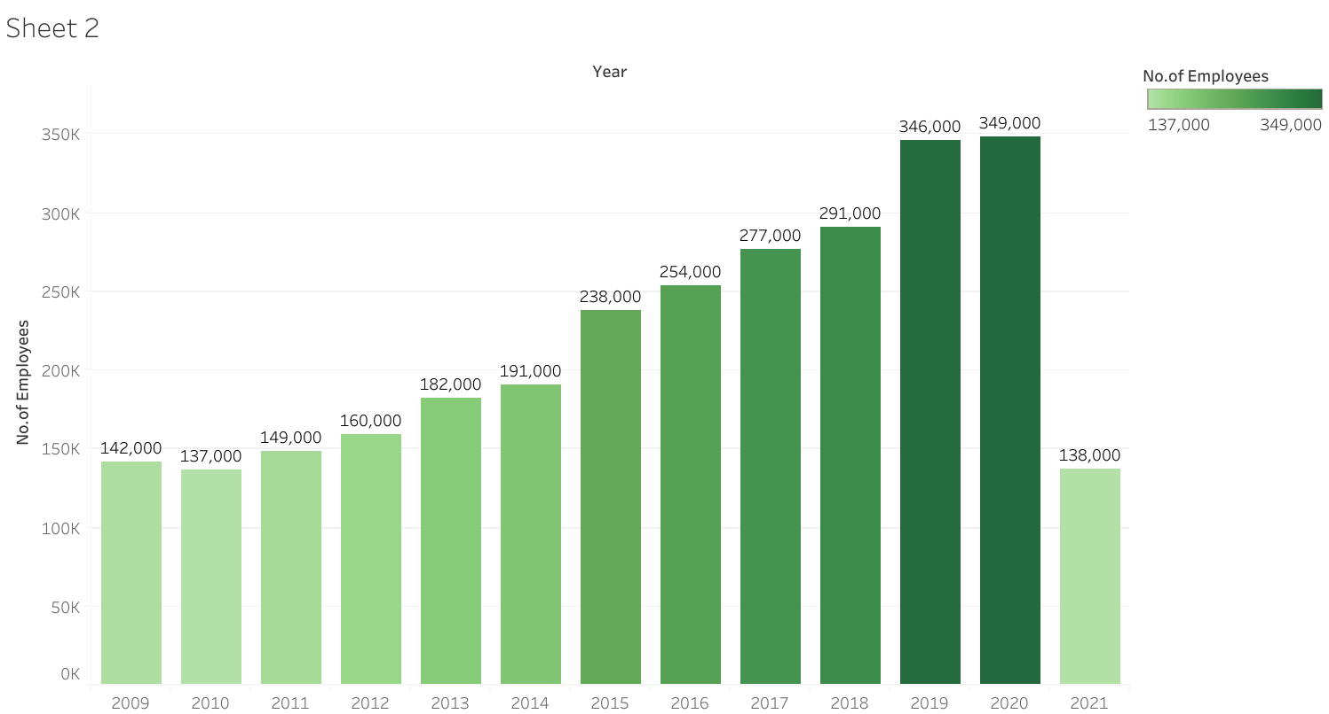

Slide 8

Customers
Market Stakholders
Suppliers
Starbucks continues to improve its corporate social responsibility practices to address the concerns of different stakeholder groups. The following are the main stakeholders in Starbucks Coffee’s business:
Environment
Investors
Government

Slide 9
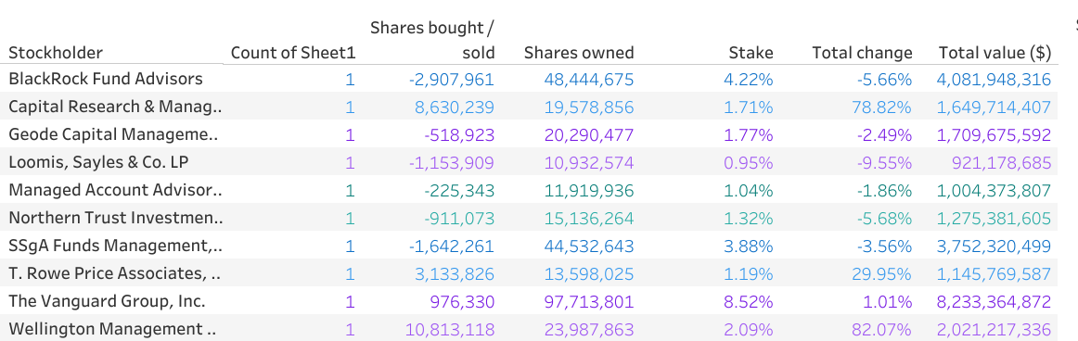
Starbucks Investors

Slide 10


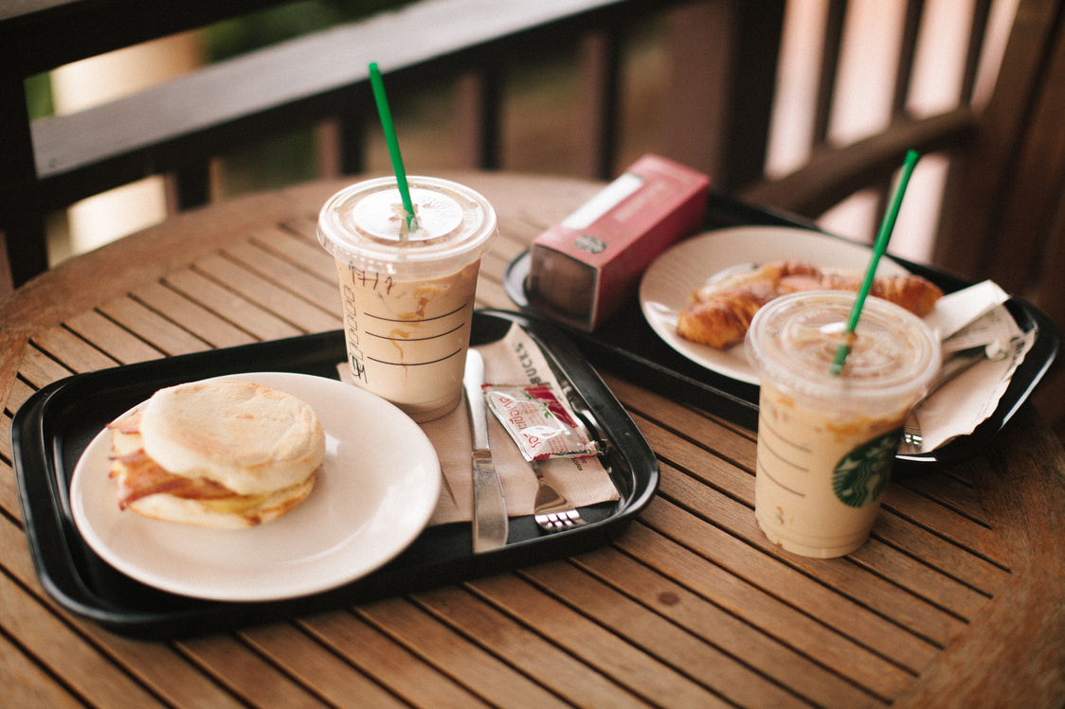
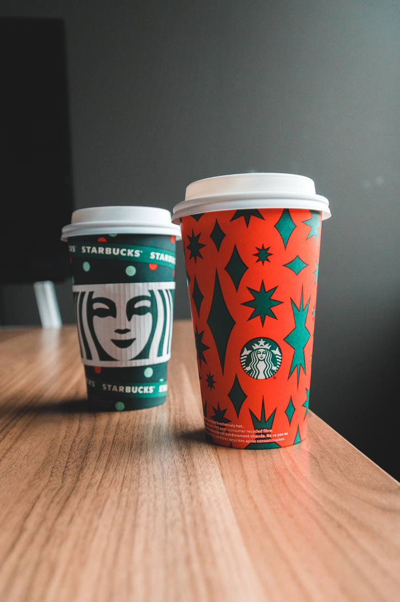
Starbucks Revenue Model
The selling of fresh beverages packed tea and coffee, and meals are part of Starbucks’ revenue stream. The Starbucks-owned outlets normally account for 79 per cent of company sales.
Premium Coffees
Whole bean coffees
Seasonal Novelty Items
Premium Teas
Food Items

Slide 11
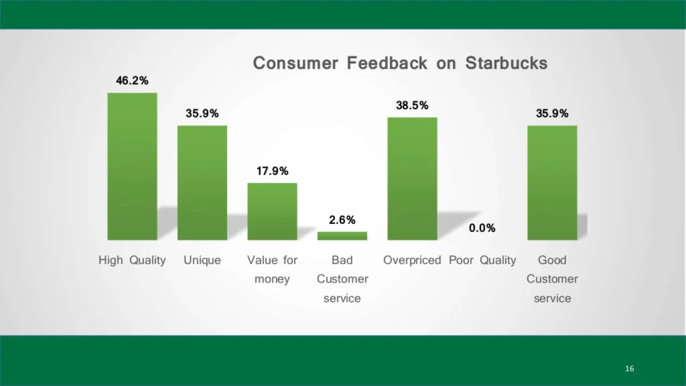

Slide 12
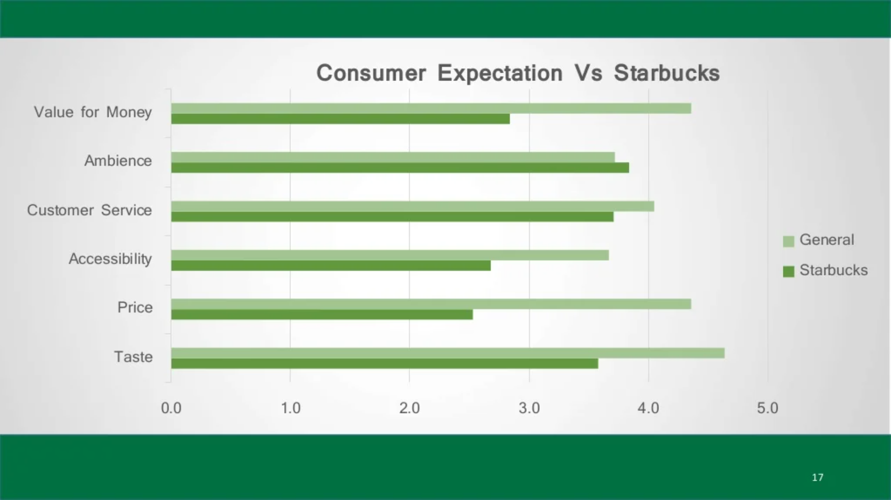

Slide 13
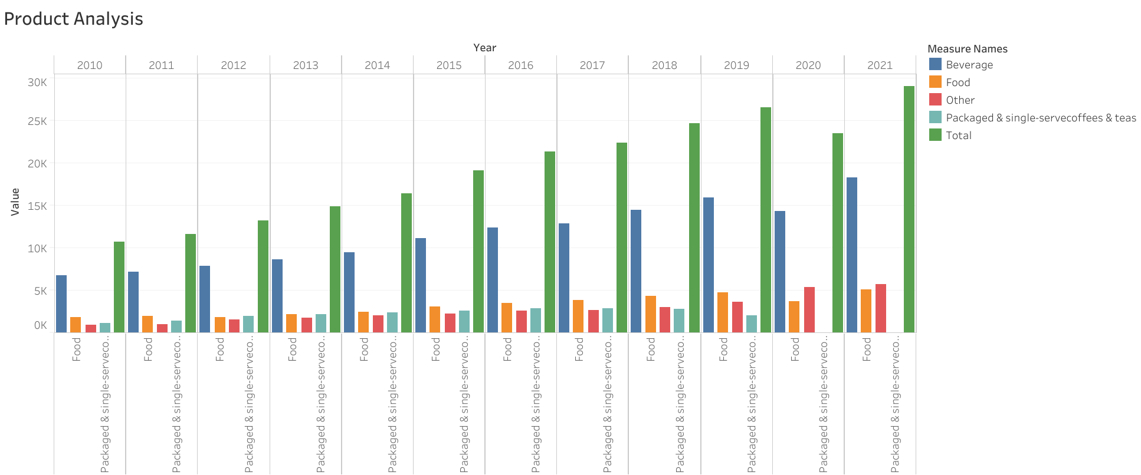

Slide 14


SWOT Analysis
S (Strengths) | W (Weaknesses) | O (Opportunities) | T (Threats)
No.1 brand in coffeehouse segment. Strong Brand Image Largest coffeehouse chain in the world. | Competitor price is the major influence. Product pricing Negative publicity | To extend supplier network. Increase product offerings Expansion of retails operations. | Increased competition from local cafes. Supply disruptions. product boycott Rising coffee beans and dairy products.

Slide 15
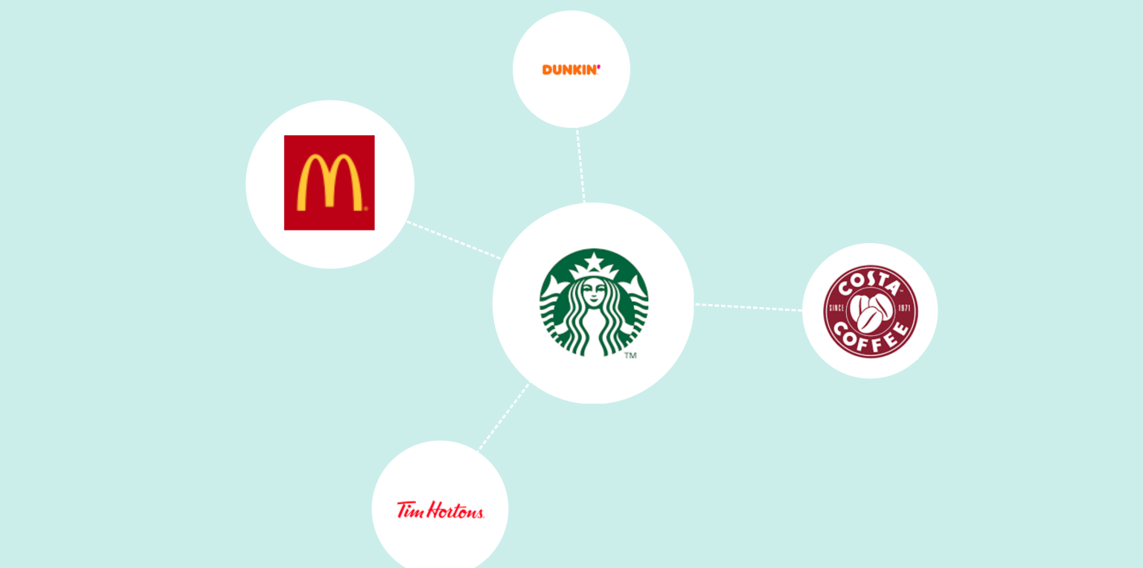
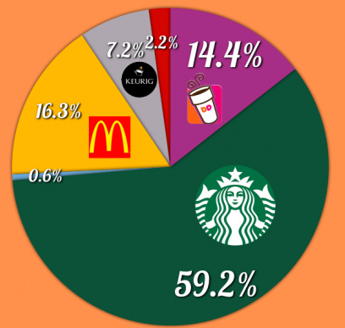
Starbucks Competitors & Market Share
Dunkin’ Donuts
McDonald’s
Costa Coffee
Tim Hortons

Slide 16
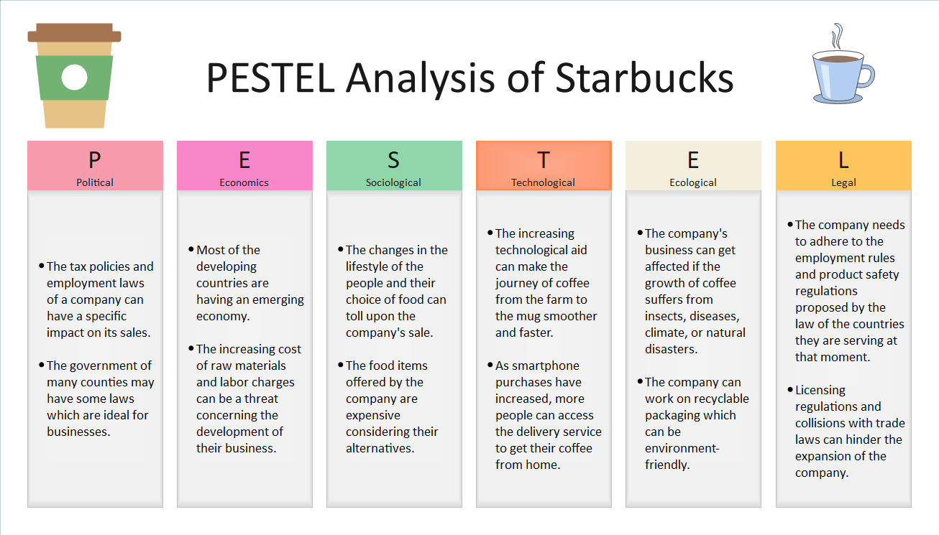

Slide 17
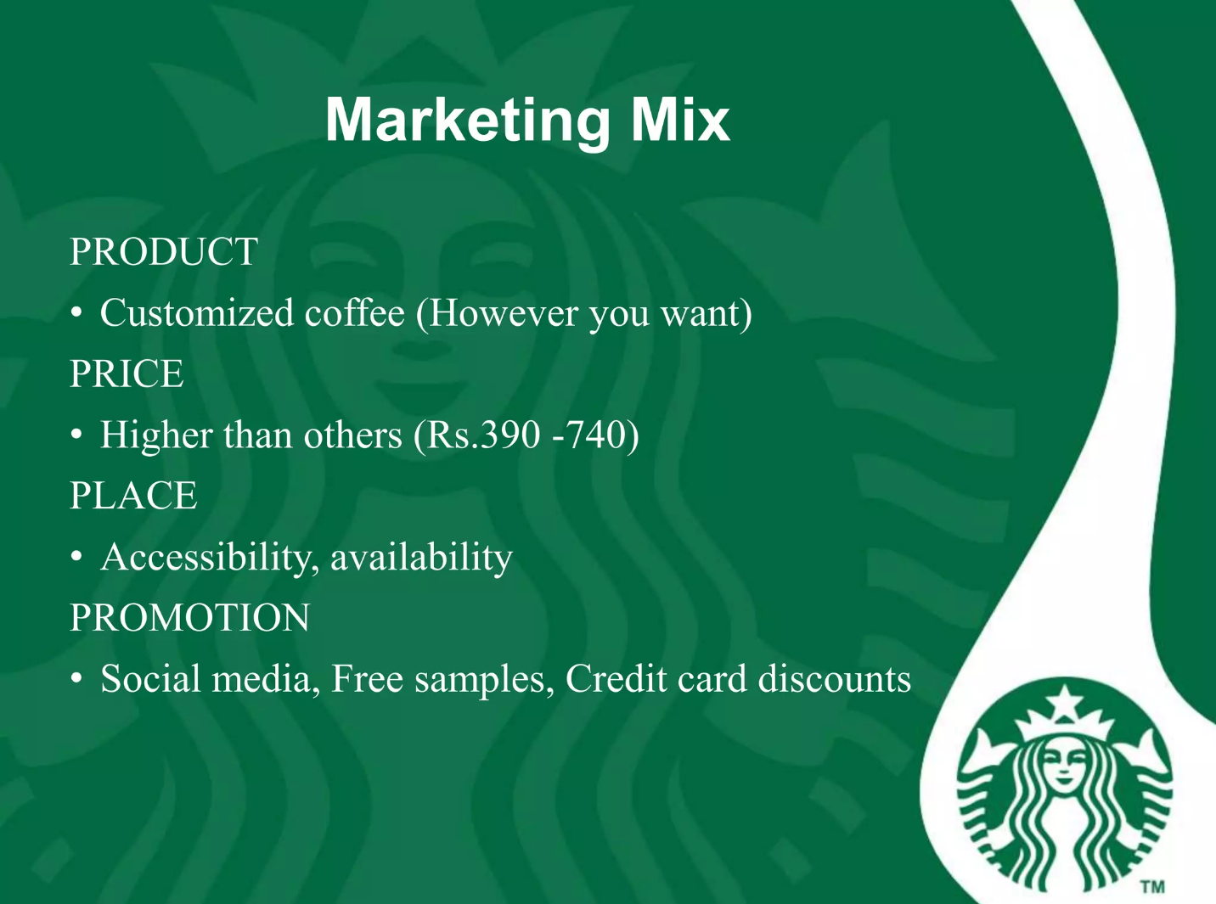

Slide 18
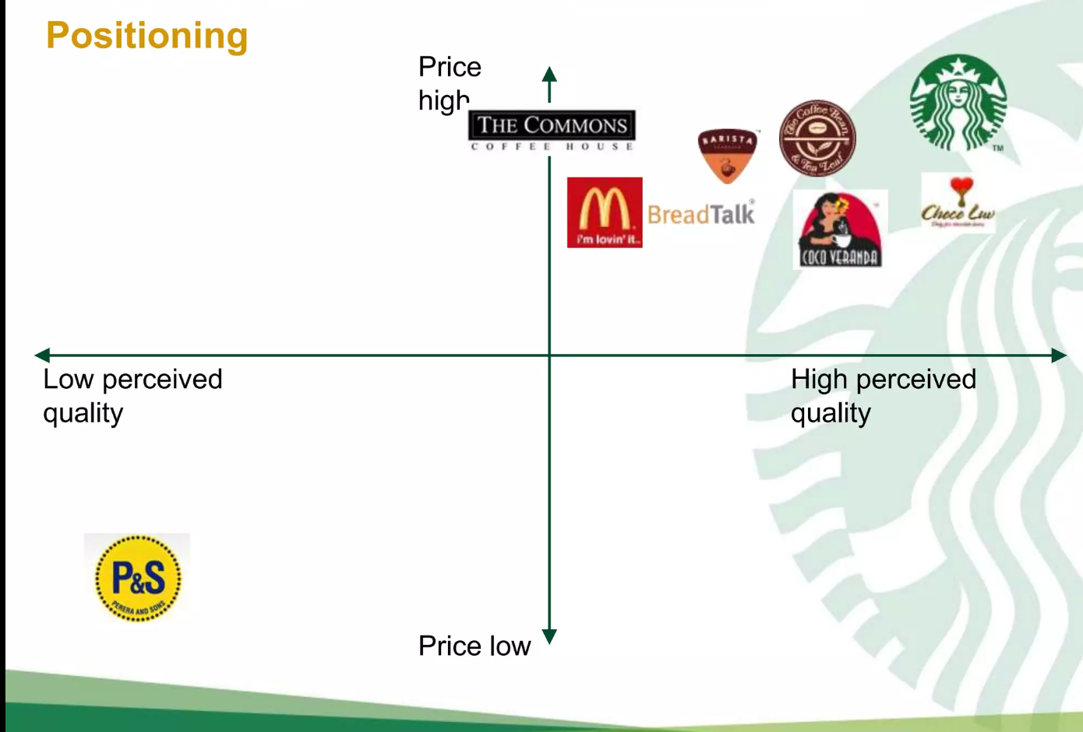

Starbucks Marketing Strategy

Slide 19

What went wrong?
Starbucks hasn't understood the coffe market in Australia.
Australian preference towards Australian Brands.
Competition from McDonalds, Gloria Jeans & Local coffee shops.
Cultural Difference.

Slide 20
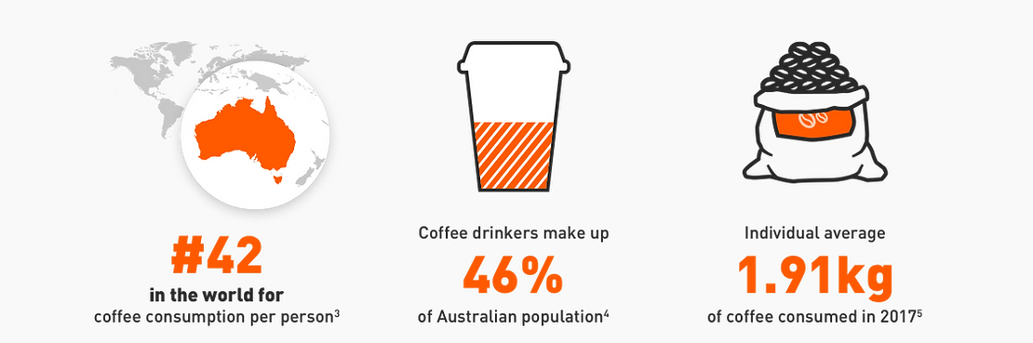
Australian Culture

Slide 21
Reasons for failure of Starbucks in Australia
Australian Coffee Culture
Quick Expansion in Australian Market
Starbucks’ Coffee – Too Sweet for Australia
Too Many Competitors

Slide 22

Recommendations
Altering the Menu
1
2
Continuing the Slow Growth
Strategy
Specialty Products
3

Slide 23


Solid research, particularly, observational and ethnographic (such as that performed by IKEA and Tesco before they open stores in new foreign markets) is extremely important. A few months of studying and spending time with coffee-drinking Australians may have saved years and millions of dollars to Starbucks in the long-run.

Slide 24
Learnings
Knowledge gained from the process of conducting the project.
Collaboration with team
Dividing complex tasks into smaller tasks
Time Managment

Slide 25
Poor Marketing
Challenges
1
Employee Motivation
2
Pricing policy
3
Coffee products
4
Rapid expansion
5

Slide 26

Thank You!

